Slide 1







Climate changes and sustainability

Slide 2
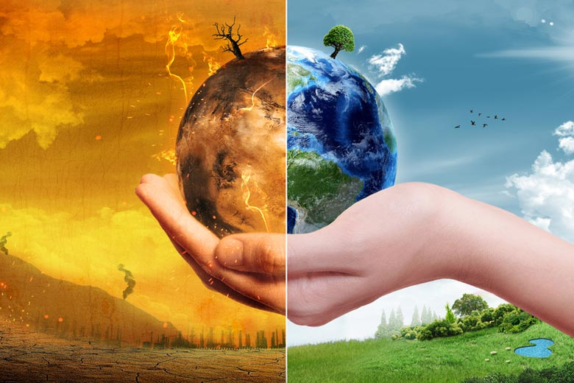

Relationship Between Climate Change and Sustainable Development
Climate change is presently a global issue that impacts the environment and society
Sustainable development aims to reduce the impacts of climate change that affect the environment

Slide 3
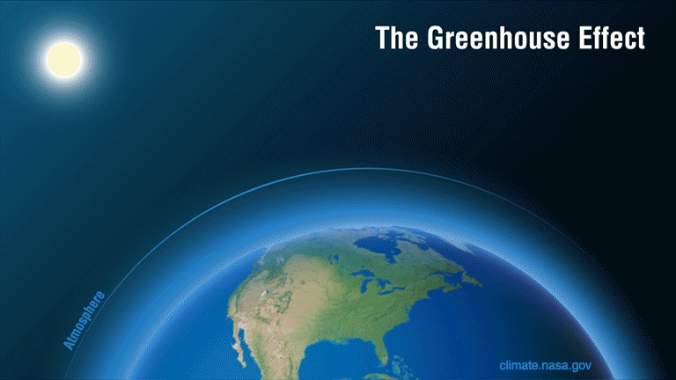
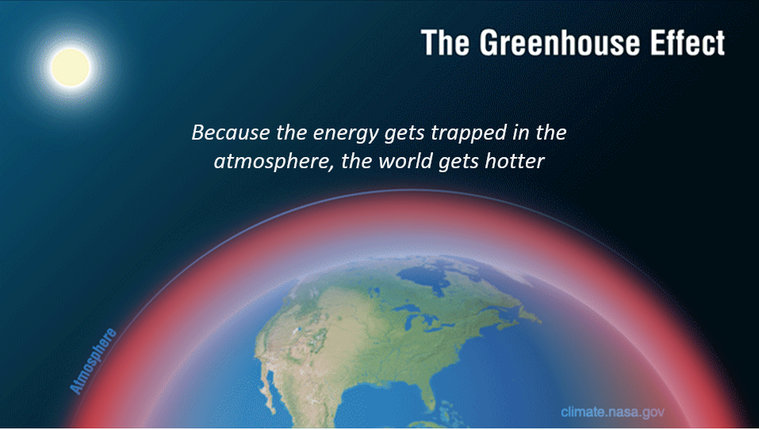

Major Cause of Climate Change
It is caused by the ‘greenhouse effect’.
But greenhouse gases in the atmosphere stop this reflection back into space
Sunlight reaches the Earth
Some is reflected back into space
Diagram: Courtesy of NASA/JPL-Caltech

Slide 4
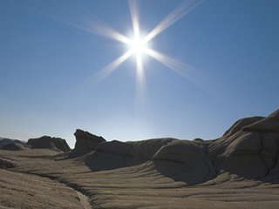

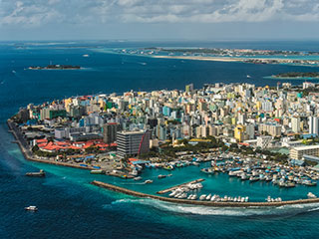
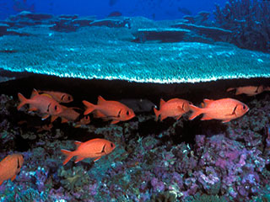
The impacts of climate change
Temperature rises – Jacobabad has recorded highest temperature reaching upto 52 C.
More extreme weather – warmer air can hold more water, so climate change is expected to lead to more floods in Pakistan and the rest of the world.
Sea-level rise – when our planet warms up, water in the ocean expands. 80% Of Maldives Might Be Underwater By 2050
Ocean acidity – the oceans absorb much of the carbon dioxide that human activities release. This makes them turn more acidic, which threatens marine life.

Slide 5

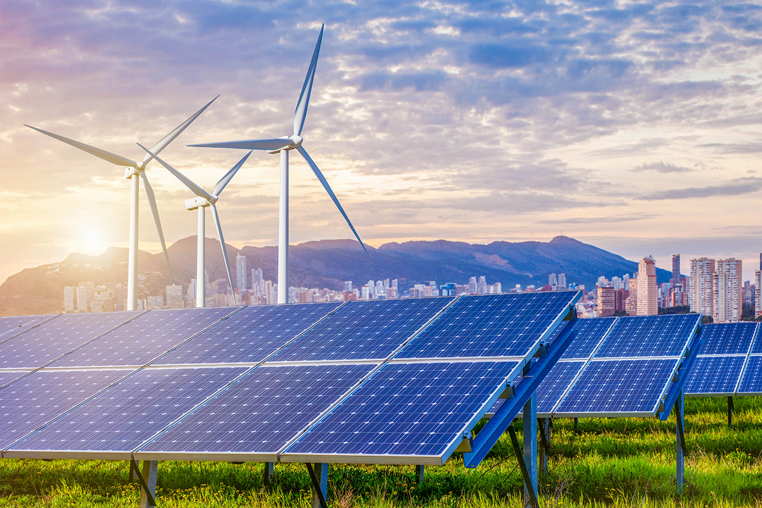

Actions to tackle the issue of climate change
Use less plastic.
Renewable energy
Use public transport

